Slide 1
Lecture 1: Introduction to Internet Technology and Basic HTML

Slide 2
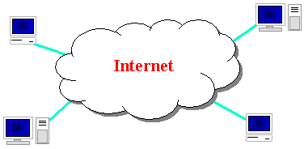
The Internet
Wikipedia: http://en.wikipedia.org/wiki/Internet
a connection of computer networks using the Internet Protocol (IP)
layers of communication protocols: IP → TCP/UDP → HTTP/FTP/POP/SMTP/SSH...

Slide 3
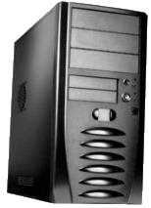
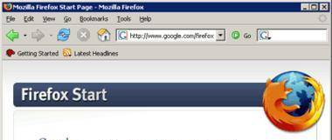
Web servers and browsers
web server: software that listens for web page requests
Apache
Microsoft Internet Information Server (IIS) (part of Windows)
web browser: fetches/displays documents from web servers
Mozilla Firefox
Microsoft Internet Explorer (IE)
Apple Safari
Google Chrome
Opera

Slide 4
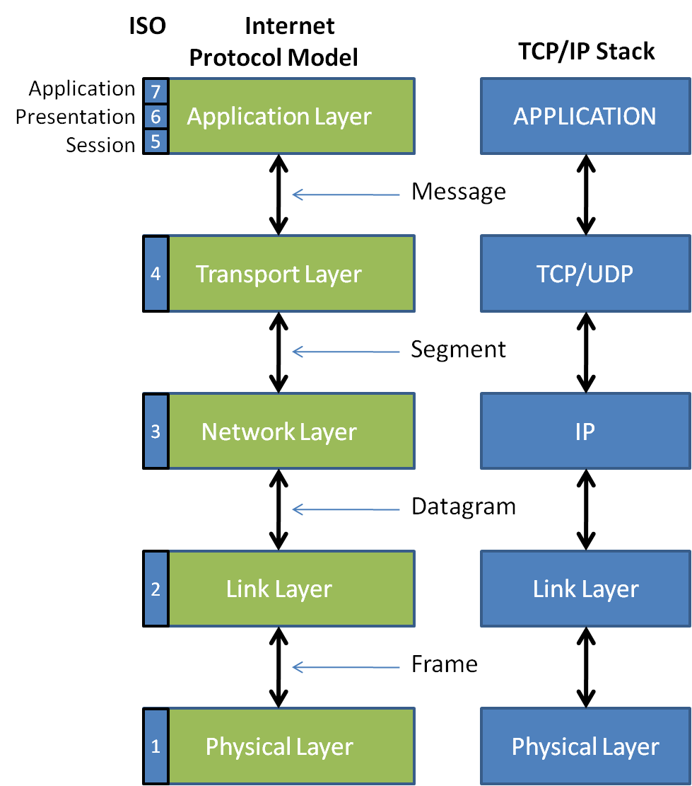
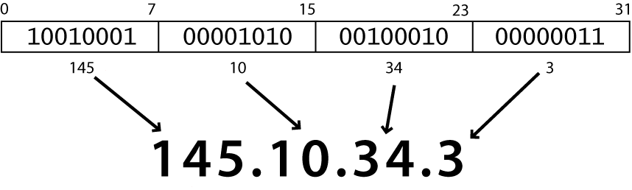
Layers of protocol
Protocol:
a set of rules governing the format of data sent
IP address:

Slide 5
Internet Protocol (IP)
a simple protocol for attempting to send data between two computers
each device has a 32-bit IP address written as four 8-bit numbers (0-255)
find out your internet IP address: whatismyip.com
find out your local IP address:
in a terminal, type: ipconfig (Windows) or ifconfig (Mac/Linux)

Slide 6
Transmission Control Protocol (TCP)
adds multiplexing, guaranteed message delivery on top of IP
multiplexing: multiple programs using the same IP address
port: a number given to each program or service
port 80: web browser (port 443 for secure browsing)
port 25: email
port 22: ssh
port 5190: AOL Instant Messenger
more common ports
some programs (games, streaming media programs) use simpler UDP protocol instead of TCP

Slide 7
How do web addresses work?
DNS:
a set of servers that map written names to IP addresses
Example: www.cs.washington.edu → 128.208.3.88
many systems maintain a local cache called a hosts file
URL:
a basic URL:http://www.aw-bc.com/info/regesstepp/index.html
~~~~ ~~~~~~~~~~~~~ ~~~~~~~~~~~~~~~~~~~~~~~~~~
protocol host path

Slide 8
Domain Name System (DNS)
a set of servers that map written names to IP addresses
Example: www.cs.washington.edu → 128.208.3.88
many systems maintain a local cache called a hosts file
Windows: C:\Windows\system32\drivers\etc\hosts
Mac: /private/etc/hosts
Linux: /etc/hosts

Slide 9
Uniform Resource Locator (URL)
an identifier for the location of a document on a web site
a basic URL:http://www.aw-bc.com/info/regesstepp/index.html
~~~~ ~~~~~~~~~~~~~ ~~~~~~~~~~~~~~~~~~~~~~~~~~
protocol host path
upon entering this URL into the browser, it would:
ask the DNS server for the IP address of www.aw-bc.com
connect to that IP address at port 80
ask the server to GET /info/regesstepp/index.html
display the resulting page on the screen

Slide 10
Hypertext Transport Protocol (HTTP)
the set of commands understood by a web server and sent from a browser
some HTTP commands (your browser sends these internally):
GET filename : download
POST filename : send a web form response
PUT filename : upload
simulating a browser with a terminal window:
$ telnet www.cs.washington.edu 80
Trying 128.208.3.88...
Connected to 128.208.3.88 (128.208.3.88).
Escape character is '^]'.
GET /index.html
<!DOCTYPE HTML PUBLIC "-//W3C//DTD HTML 4.0 ...">
<html>
...

Slide 11



Who "runs" the internet?
Internet Engineering Task Force (IETF): internet protocol standards
Internet Corporation for Assigned Names and Numbers (ICANN):
decides top-level domain names
World Wide Web Consortium (W3C): web standards

Slide 12

Brief History
began as a US Department of Defense network called ARPANET (1960s-70s)
initial services: electronic mail, file transfer
opened to commercial interests in late 80s
WWW created in 1989-91 by Tim Berners-Lee
popular web browsers released: Netscape 1994, IE 1995
Amazon.com opens in 1995; Google January 1996
Hamster Dance web page created in 1999

Slide 13
Web languages / technologies
Hypertext Markup Language (HTML): used for writing web pages
Cascading Style Sheets (CSS): stylistic info for web pages
PHP Hypertext Processor (PHP): dynamically create pages on a web server
JavaScript: interactive and programmable web pages
Asynchronous JavaScript and XML (Ajax): accessing data for web applications
eXtensible Markup Language (XML): metalanguage for organizing data
Structured Query Language (SQL): interaction with databases

Slide 14
Hypertext Markup Language (HTML)
describes the content and structure of information on a web page
not the same as the presentation (appearance on screen)
surrounds text content with opening and closing tags
each tag's name is called an element
syntax: <element> content </element>
example: <p>This is a paragraph</p>
most whitespace is insignificant in HTML (ignored or collapsed to a single space)
we will use a newer version called HTML5

